Slide 1

Managing Your Stress and Worry
Colleen M. Cummings, Ph.D.
Clinical Psychology Associates of
North Central Florida
Gainesville – Ocala
(352) 33-2888
www.CPANCF.COM
Presented October 20th, 2013
All rights reserved

Slide 2
Stress Levels in the U.S.
Adults are living with moderate to high levels of stress
They recognize that these levels are high but report being too busy as a barrier to making changes
Money, work and the economy are the highest stressors
91% of children say they can tell when their parents are stressed
Women report higher levels of stress than men, particularly married women
*from the Stress in America Survey (2010)
www.CPANCF.COM Clinical Psychology Associates of North Central Florida (352) 336-2888

Slide 3
Symptoms of Stress
40% of adults report overeating due to stress
30% report skipping a meal due to stress
4 in 10 report lying awake at night at least once per month
Most common symptoms of stress include:
  Irritability
  Fatigue
  Lack of motivation
  *from the Stress in America Survey (2010)
Clinical Psychology Associates of North Central Florida www.CPANCF.COM (352) 336-2888

Slide 4

Myths about Stress
Stress is the same for everyone
Stress is always bad for you
Stress is everywhere, so you can’t do anything about it
The most popular or “hyped” techniques are the best ones
No symptoms means you have no stress
Only major symptoms of stress are problematic
*from Miller and Smith, The Stress Solution
www.CPANCF.COM Clinical Psychology Associates of North Central Florida (352) 336-2888

Slide 5

Our Stress Toolkit
Clinical Psychology Associates of North Central Florida
(352) 336-2888 www.CPANCF.COM

Slide 6
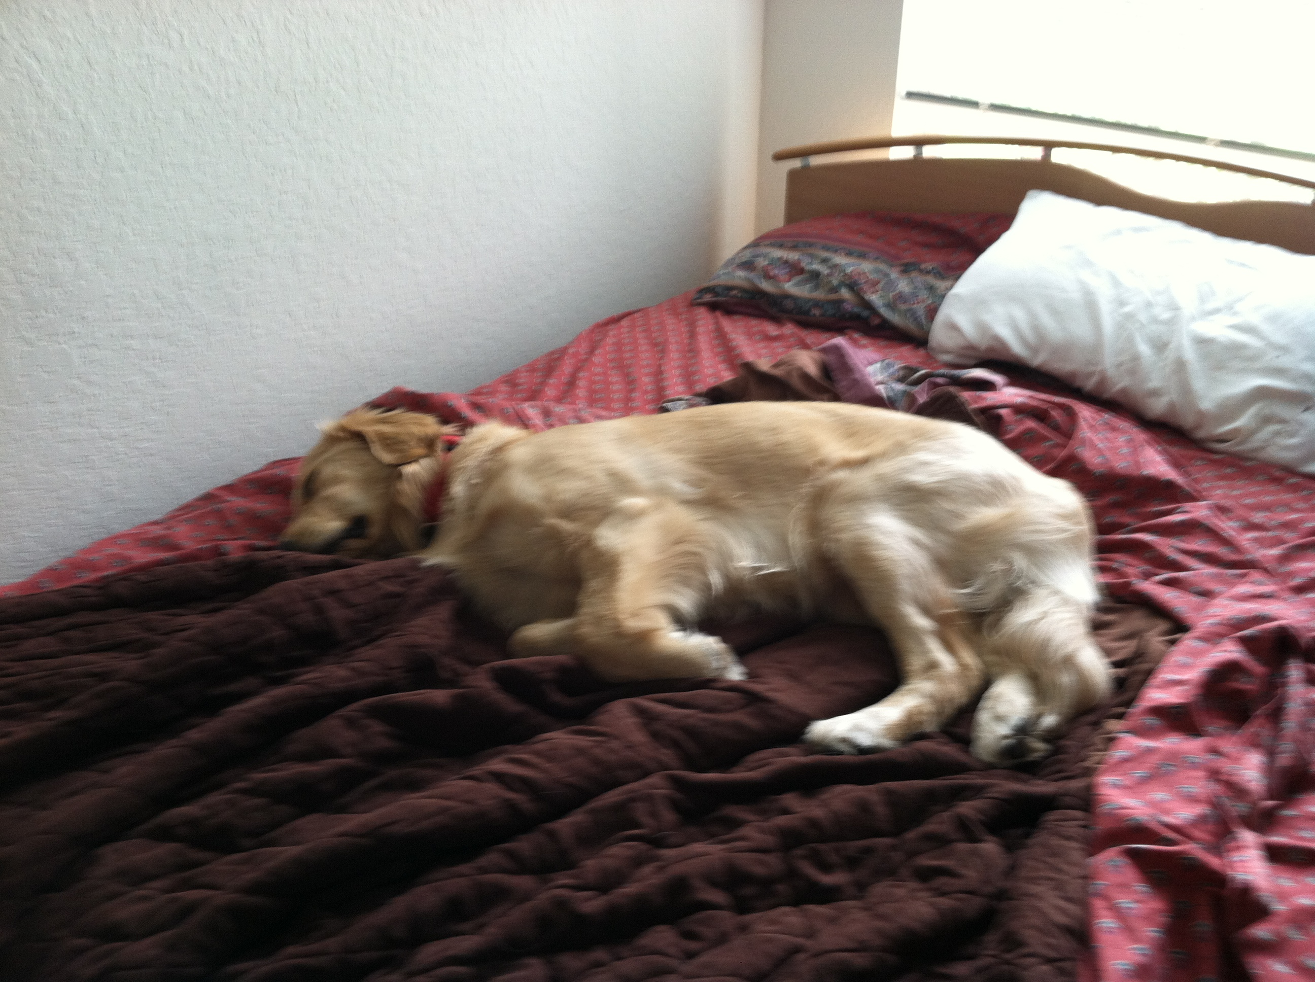
Tip # 1 Self-Care
Set yourself up for success by:
  Getting enough sleep
  Eating well
  Exercising
  Avoiding bad habits
www.CPANCF.COM
Clinical Psychology Associates of North Central Florida (352) 336-2888

Slide 7
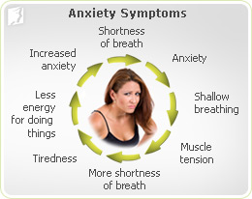
Tip # 2 Know Yourself
Know your individual experience with stress
  How do you experience stress?
  What are your triggers?
  How are you handling it now?
www.CPANCF.COM Clinical Psychology Associates of North Central Florida (352) 336-2888

Slide 8
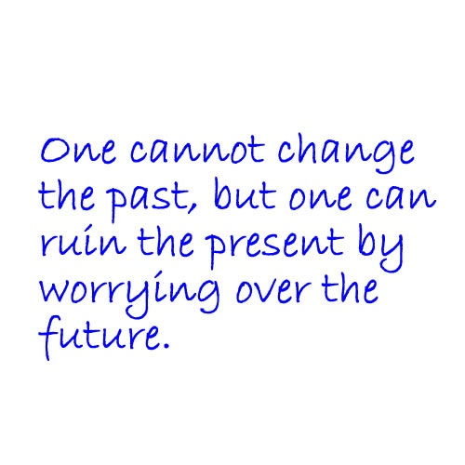
Tip # 3. Recognize your anxious thoughts
When we worry we tend to:
  Focus on the future
  Focus on the past
  Assume the worst outcomes
  Feel incompetent
www.CPANCF.COM
Clinical Psychology Associates of North Central Florida (352) 336-2888

Slide 9
Tip # 4 But don’t give in to them
Try not to engage with the thought
But also don’t exert a lot of effort pushing it aside
Notice it
Give it a moment
Go back to what you are doing
From Freeman, Freeman, & Garety (2006)
www.CPANCF.COM
Clinical Psychology Associates of North Central Florida (352) 336-2888

Slide 10

Tip # 5: Don’t take your worries to bed
Worrying is related to initial insomnia, middle insomnia, and early morning awakening
But, we are not at our best to problem-solve at night
Set aside 10 minutes of Worry Time to go over your worries of the day
From Perlis, Jungquist,
Smith, & Posner (2008)
www.CPANCF.COM Clinical Psychology Associates of North Central Florida (352) 336-2888

Slide 11

Tip # 6 Actively Problem-Solve
Try to notice your mindless or purposeless worrying and save it for problem-solving later
Follow our steps:
  Identify the problem
  Consider possible solutions
  Evaluate alternatives
  Choose one
  Later, reflect on your decision
www.CPANCF.COM Clinical Psychology Associates of North Central Florida (352) 336-2888

Slide 12

Tip # 7 Be in the present
When was the last time you allowed yourself to be in the now?
www.CPANCF.COM
Clinical Psychology Associates of North Central Florida (352) 336-2888

Slide 13
Tip # 8 Reach out to others
Oxytocin levels are high during stressful experiences, encouraging us to seek out support (Heinrich et al., 2003)
  Watch out for co-rumination!
Build a quality support network
When to seek extra help?
www.CPANCF.COM Clinical Psychology Associates of North Central Florida (352) 336-2888

Slide 14

Tip # 9 Be Active
Exercise has mood enhancement benefit
Comparable short and longterm outcomes to antidepressants to individuals with depression (Blumenthal, 2010)
Minimizes panic attacks (Smits & Otto, 2011)
www.CPANCF.COM Clinical Psychology Associates of North Central Florida (352) 336-2888

Slide 15

Tip # 10 Practice Relaxation
Notice your tension and breathing
Deep breathing exercise
Progressive Muscle Relaxation
Visualization
www.CPANCF.COM Clinical Psychology Associates of North Central Florida (352) 336-2888

Slide 16

Now Make a Plan
Pick a few tools that work for you and fit them in your life
Allow time to see an effect
Keep trying!

Slide 17
Book Recommendations
Full Catastophe Living: Using the Wisdom of Your Body and Mind to Face Stress, Pain, and Illness by Jon Kabat-Zin
10 Simple Solutions to Worry: How to Calm Your Mind, Relax Your Body, and Reclaim Your Life by Kevin L. Gyoerkoe and Pamela S. Weigartz
The Power of Now by Eckhart Tolle
Mastery of Your Anxiety and Worry: Workbook by Michelle G. Craske and David H. Barlow

